Slide 1

BASIC ELECTRICAL AND ELECTRONICS ENGINEERING
Course Code: CSE1002
SCHOOL OF COMPUTER SCIENCE ENGINEERING AND APPLICATIONS
Mrunmayee Rahate
Assistant Professor, DYPIU

Slide 2
Module 2: Semiconductor Devices and Applications
Lecture 2: P-N Junction Diode: Working Principle and Characteristics, Diode Approximations

Slide 3
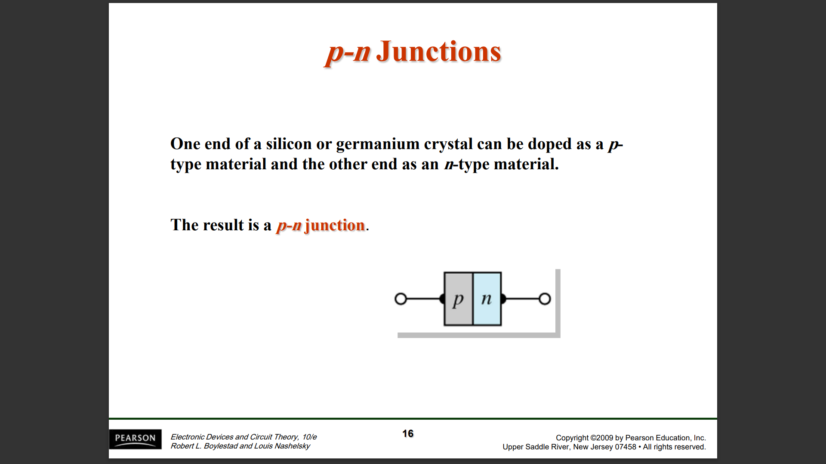

Slide 4
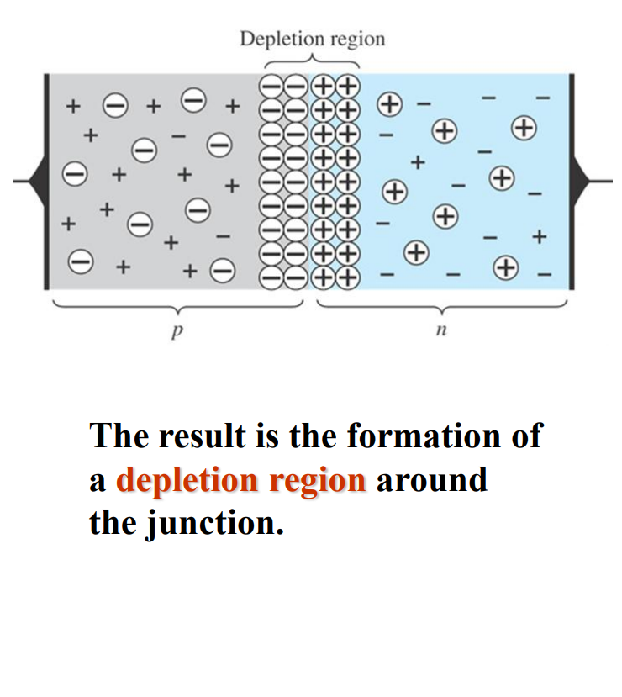
Free electrons in the n region near the pn junction begin to diffuse across the junction and fall into holes near the junction in the p region
For every electron that diffuses across the junction and combines with a hole, a positive charge is left in the n region
A negative charge is created in the p region, forming a barrier potential.
This action continues until the voltage of the barrier repels further diffusion.
A potential difference across the junction due to the depletion region (positive ions in the n-Type region and the negative ions in the p-Type region) is called as the barrier potential
It’s value is 0.7 V for Silicon (Si) and 0.3 V for Germanium (Ge)

Slide 5
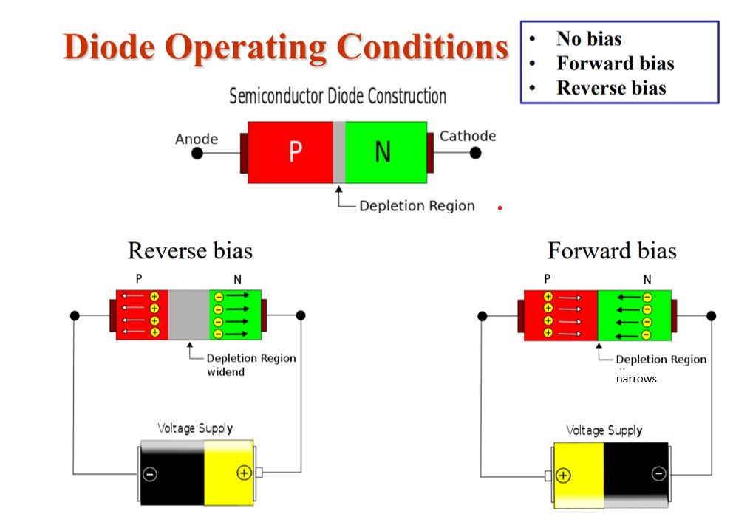

Slide 6
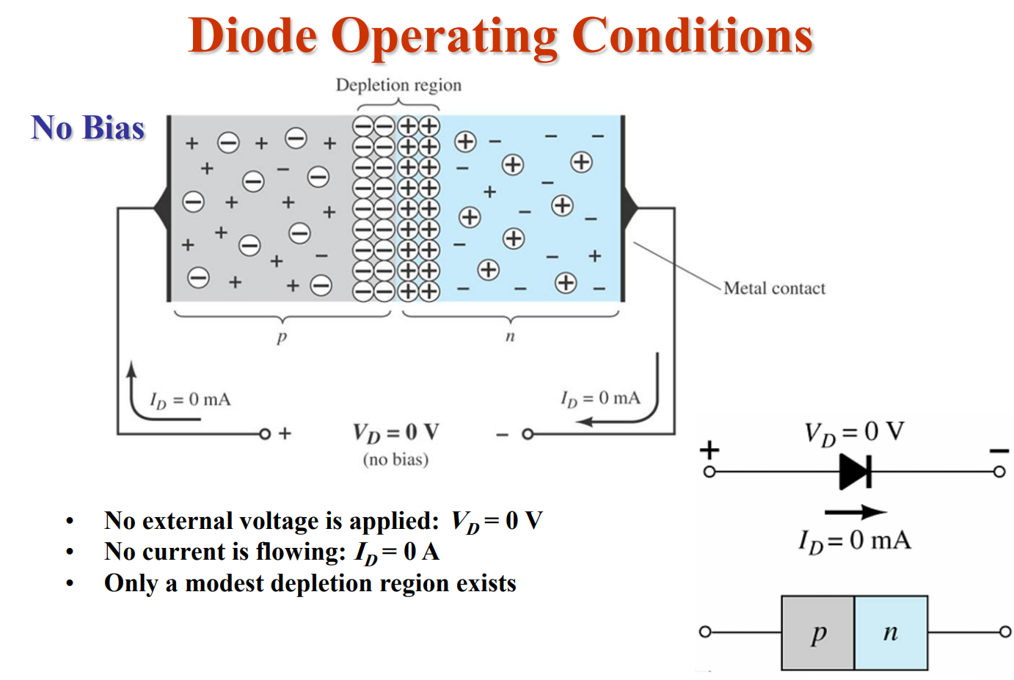

Slide 7
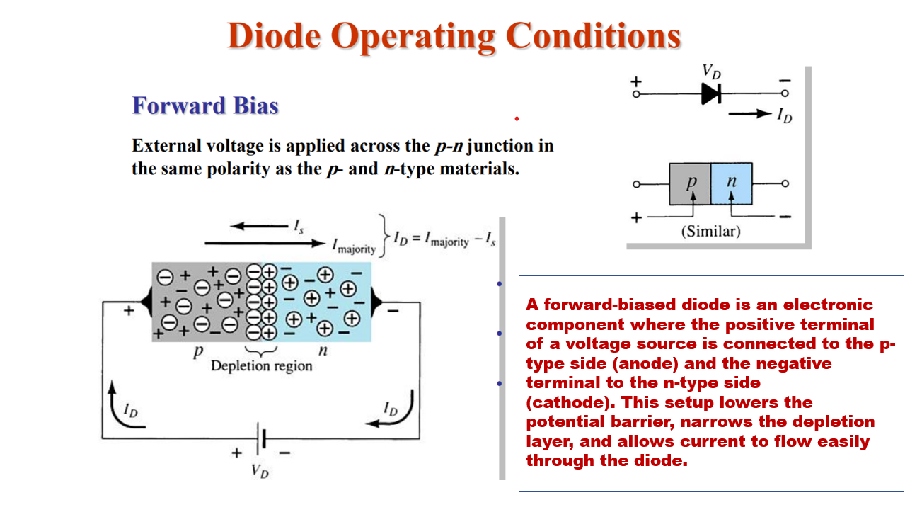

Slide 8
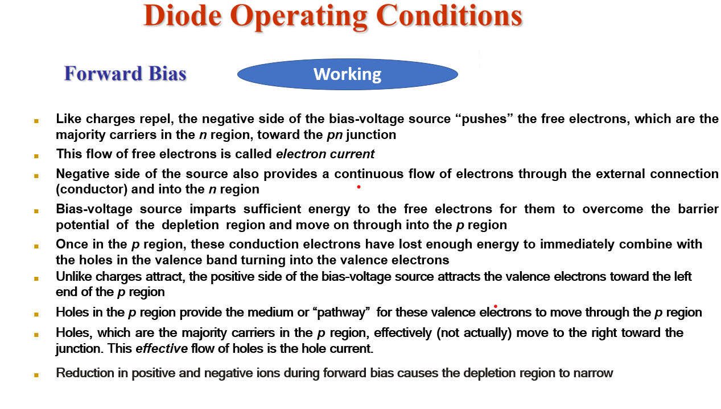

Slide 9
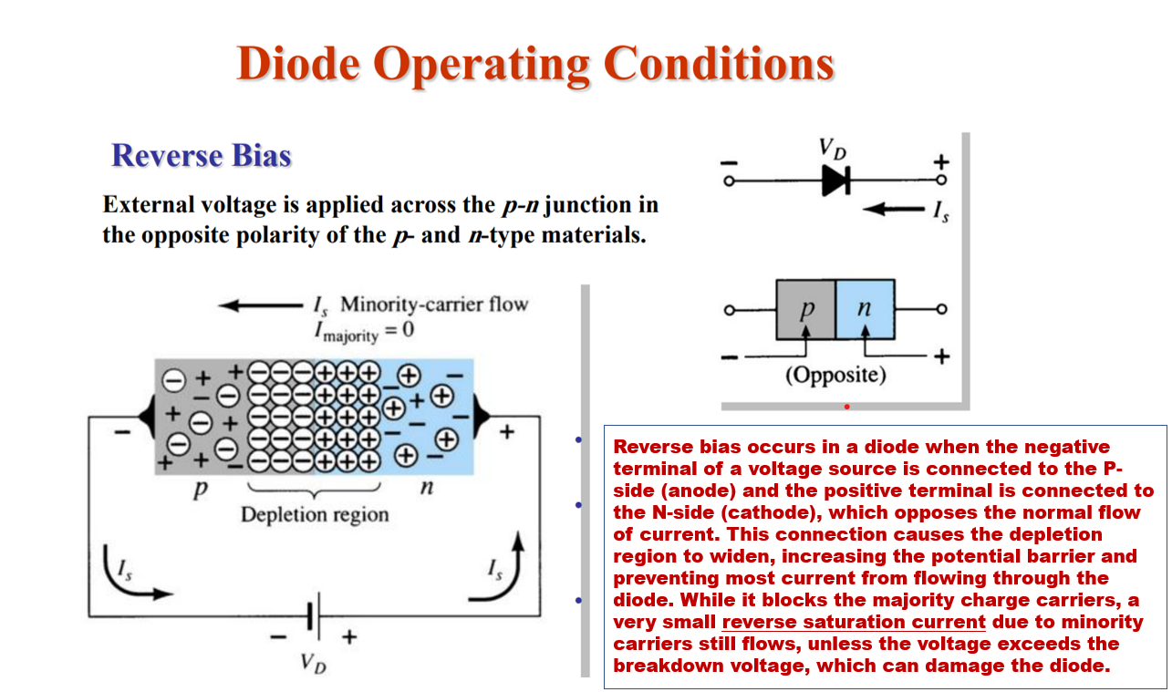

Slide 10
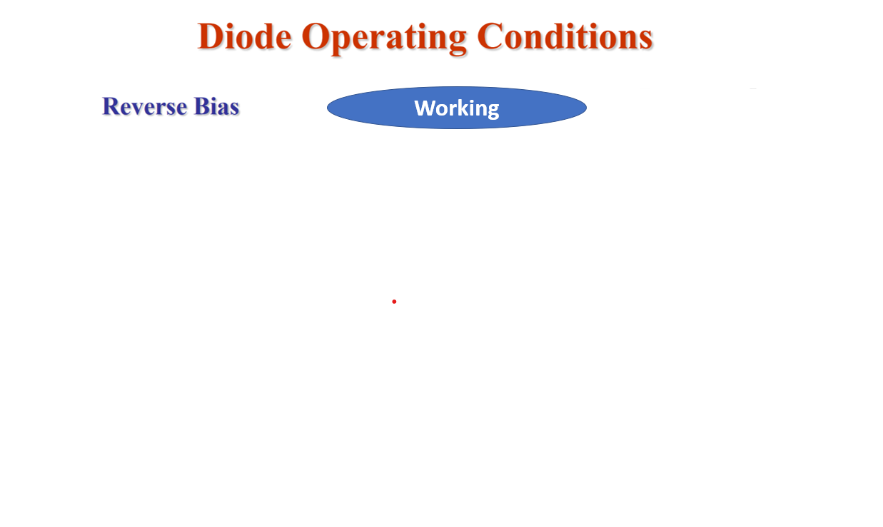
Unlike charges attract, the positive side of the bias-voltage source “pulls” the free electrons, which are the majority carriers in the n region, away from the pn junction
As the electrons flow toward the positive side of the voltage source, additional positive ions are created
This results in a widening of the depletion region and a depletion of majority carriers
In the p region, electrons from the negative side of the voltage source enter as valence electrons and move from hole to hole toward the depletion region where they create additional negative ions
The flow of valence electrons can be viewed as holes being “pulled” toward the positive side
This results in a widening of the depletion region and a depletion of majority carriers
As more of the n and p regions become depleted of majority carriers, the electric field between the positive and negative ions increases in strength until the potential across the depletion region equals the bias voltage, VBIAS
At this point, the transition current essentially ceases
Thus, initial flow of majority charge carriers is transitional and lasts for only a very short time after the reverse-bias voltage is applied

Slide 11
At the same time, the small number of free minority electrons in the p region are “pushed” toward the pn junction by the negative bias voltage
When these electrons reach the wide depletion region, they easily pass through the depletion region as they require no additional energy
These electrons combine with the minority holes in the n region as valence electrons and flow toward the positive bias voltage, creating an extremely small current
Thus, the extremely small current that exists in reverse bias after the transition current dies out is called as the reverse current and is caused by the minority carriers in the n and p regions generated due to thermal agitation
Normally, the reverse current is very small and can be neglected
Now, if the external reverse-bias voltage is increased to a value called as breakdown voltage, it imparts energy to the free minority electrons so that as they speed through the p region, they collide with atoms with enough energy to knock valence electrons out of their orbit and into the conduction band
The newly created conduction electrons are also high in energy and repeat the process, thus the number of electrons quickly multiply
The reverse current increases drastically to the value called as reverse saturation current
This may permanently damage the diode if steps are not taken to limit the current
This effect is known as the avalanche multiplication

Slide 12
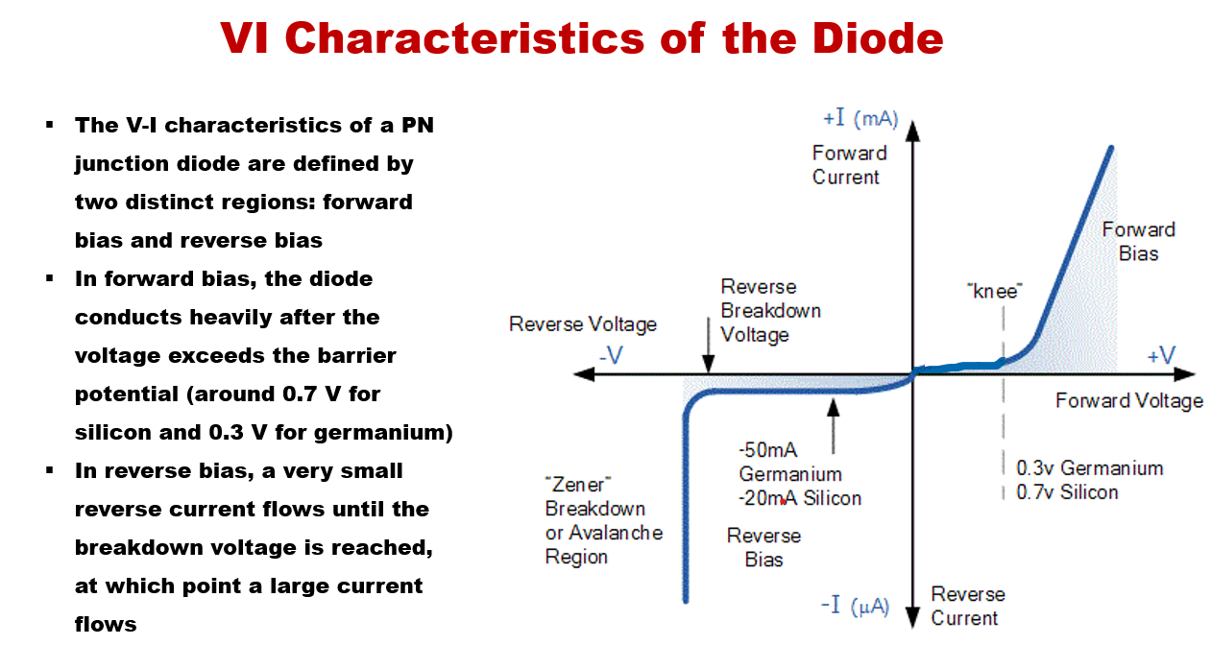

Slide 13
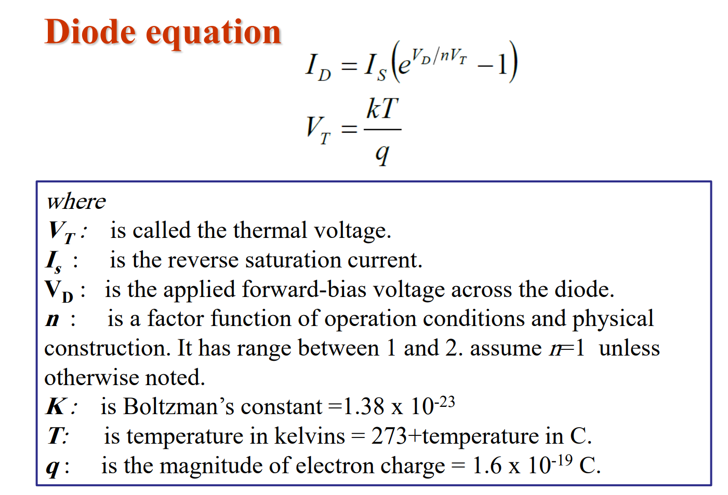

Slide 14
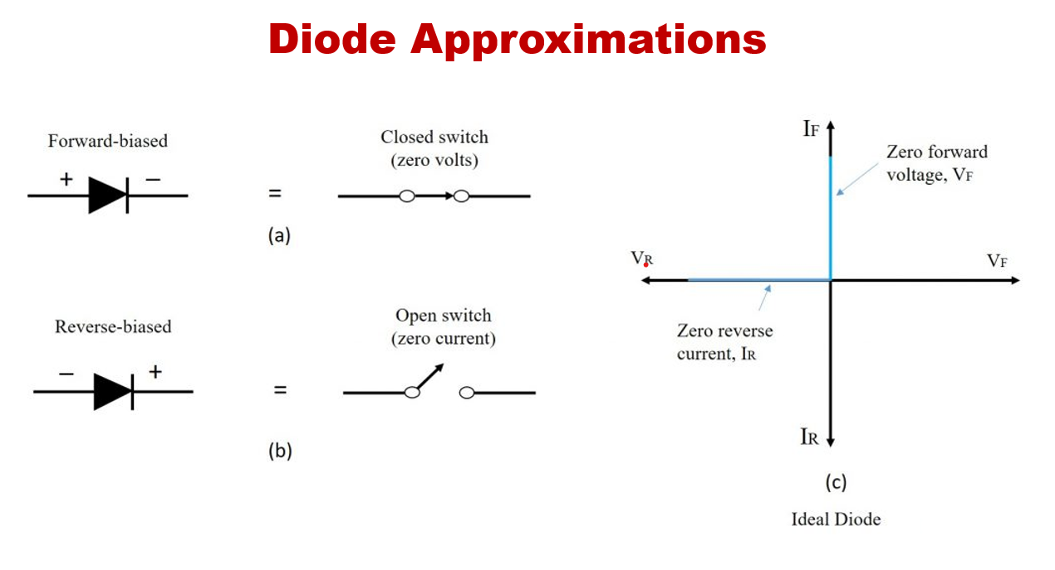

Slide 15
Thank You !!!

